Slide 1
The Bankers

Slide 2
01
02
03
ABOUT US
OUR SERVICES
OUR TEAM

Slide 3

ABOUT US
The Bankers
We constructed our team on the idea of making a platform for people to securely store and bequeath their digital will.

Slide 4
Our services
Our services include:
Secure storage of digital assets and valuables
Transfer of digital affiliation to designated users

Slide 5






Software used
Microsoft Teams
Discord
Visual Studio Code
Microsoft Word
Microsoft PowerPoing
GitHub

Slide 6
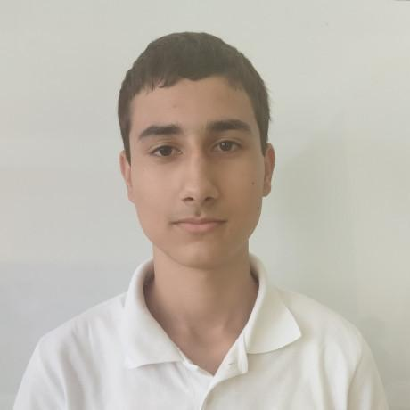
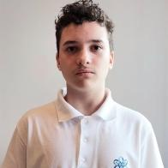
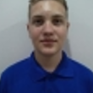
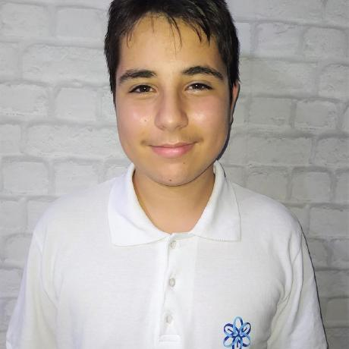
Valentin Lazarov
Gabriel Dimitrov
Alexander Sivkov
Daniel Stefanov
Our Team
Scrum Trainer
Backend Developer
Backend Developer
Backend Developer

Slide 7
Now let's continue to the site

